Slide 1
Banking Bot
(AI)
Product Manager: Marcos Bittencourt
Project by Brainy Bots
- Prashant Kumar Jha (Tech Lead/ Devops)
- Avinash Mishra (AI Analyst)
Dheeraj Pagare (Backend)
Harpreet Kaur (Data Analyst)
Kunwarpreet Saggu (Frontend/Tester)

Slide 2
Agenda
01
02
03
04
What Chatbot do?
06
Use cases
Types of Chatbot
07
Technical Workflow
AI Banking Bot
08
Tools & Technology
Architecture
09
Challenges
05
Scope

Slide 3
01
What Chatbot do?
(AI)

Slide 4
What Chatbot do?
Chatbots, no matter where you find them, are designed to have conversations with humans. These conversations range from the rudimentary (e.g. “Tell me what time the train arrives”) to the more advanced (e.g. the likes of Alexa and Siri).
Here are some things chatbots can do:
Hold a human-like conversation
Answer user questions
Collect and analyze data
Guide users through processes
Use predictive analytics to provide personalized services to the users

Slide 5
02
Types of Chatbot
(AI)

Slide 6
Types of Chatbot
(a) Rule-based chatbots
These are your basic question-answer, decision tree program, that can only hold a conversation as long as the user says the right thing – and this is as good as it gets with them. An example would be asking the chatbot to pull an article from a knowledge base or asking how much a particular product costs
(b) Smart chatbots
These "smart" bots use more powerful artificial intelligence, machine learning and predictive analytics, and are therefore better equipped to “sound” human and learn as they go. AI bots analyze a user’s input and employ technology like natural language understanding (NLU) to determine what the user means instead of just what they said. Then, they’re able to generate their own appropriate responses (think natural language generation or NLG). Understanding context is perhaps the key function of advanced AIs.

Slide 7
03
AI Banking Bot
(AI)

Slide 8
AI powered Chatbot
(a) Sentiment Analysis:
This enables the chatbot to detect and address customer dissatisfaction (By Emoji)or identify potential issues that require attention.
(b) Personalization:
It can provide recommendations to the customers, financial advice, or product suggestions based on the user's preferences, transaction history, and financial goals.
(c) Fraud Detection:
AI algorithms can be used to analyze customer login and transactional patterns to identify potential fraudulent activities.

Slide 9
04
Architecture
(AI)

Slide 10
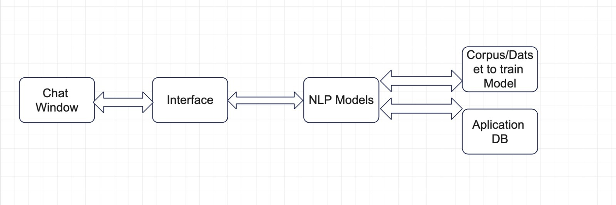
High Level Architecture

Slide 11
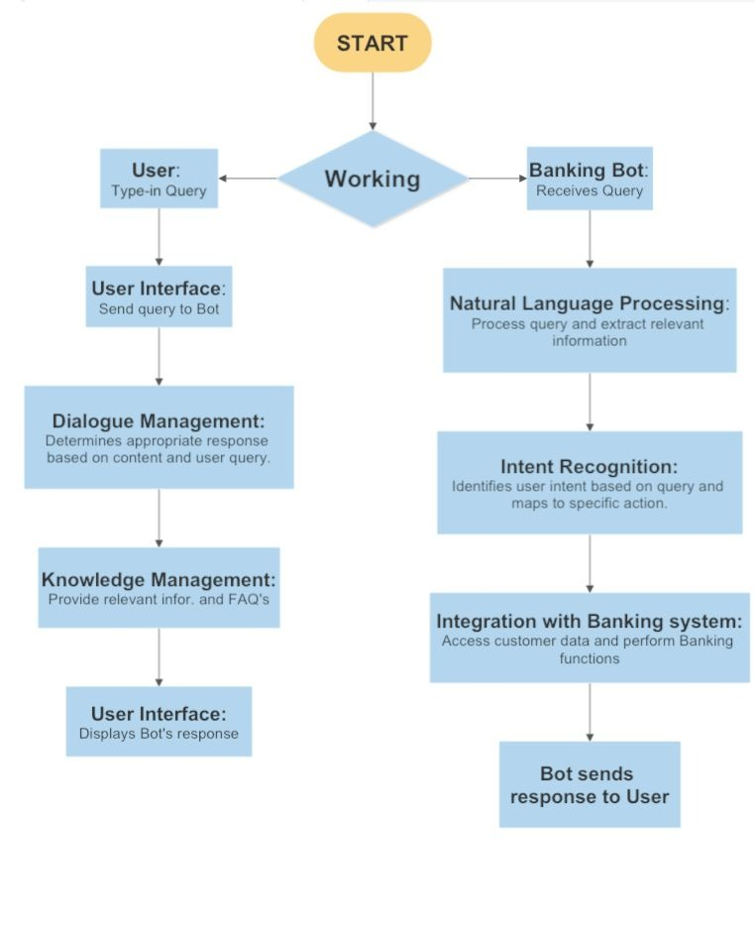
Flow Chart

Slide 12
05
Scope
(AI)

Slide 13
Scope of AI based Banking Chatbot
FAQs:
Develop a chatbot capable of answering common banking-related queries and providing accurate and relevant information.
Transfer:
Implement a secure and seamless transfer feature that allows users to initiate funds transfer between their own accounts or to other recipients.
Add Account:
Enable users to add new accounts to their existing profile, providing a streamlined process for account creation and integration into the chatbot system.
Reminders:
Incorporate a reminder functionality that allows users to set reminders for important banking tasks, such as bill payments, account updates, or document submissions.
Account Details:
Integrate a feature to retrieve and display comprehensive account details, including balances, transaction history, statements, and account-specific information.
Transaction:
Enable users to initiate various banking transactions, such as bill payments, fund transfers, balance inquiries, and transaction history requests, with the chatbot as an intermediary.
Loan:
Provide assistance and information regarding loan products offered by the bank, including eligibility criteria, interest rates, application procedures, and repayment options.

Slide 14
06
Use case Diagram
(AI)

Slide 15
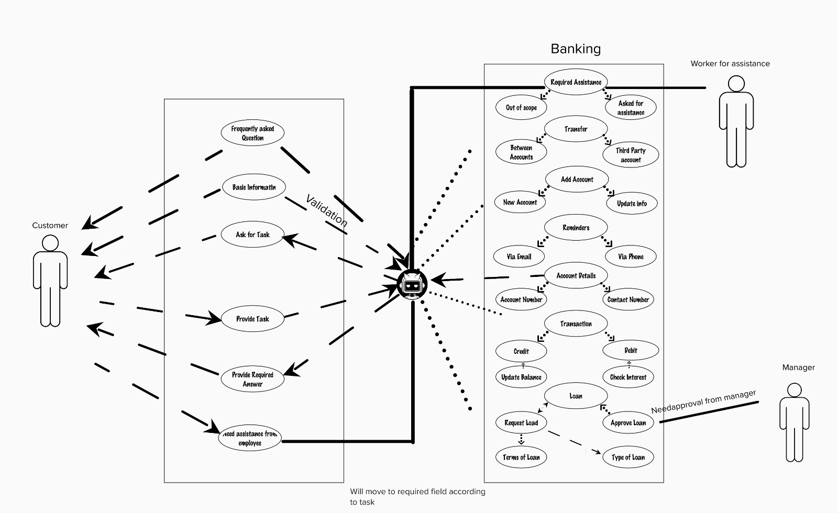
Use Case Diagram
User Interface

Slide 16

07
Technical Workflow
(AI)

Slide 17



Technical Workflow
Set up your development environment
Install Python and any necessary libraries or frameworks, such as NLTK, TensorFlow, or scikit-learn. Set up a virtual environment to manage dependencies.
Define intents
and actions
Define the different purpose or actions of banking bot. Common examples include account balance inquiries, fund transfers, loan applications, or credit card information
Define & pre-process
training data
We need to gather the dataset that contains user queries and once the dataset is available pre-processing needs to be done by normalizing, cleaning and splitting the dataset into training and test sets.

Slide 18



Technical Workflow
Build language understanding
model
Pre-processed data need to be converted into language that machine can understand. Techniques like bag-of-words or word embeddings can be used.
Implement dialogue management
Creating bot's dialogue flow and logic to be able to handle various intents and actions. Create a system that will respond to queries or initiate the proper activities in accordance to the identified intent
Backend integration
connect bot to backend system using APIs to fetch transaction record and account info.

Slide 19



Technical Workflow
Develop and integrate UI
Integrate with UI module
Testing
Test to valid accuracy and functionality.
Deployment & Monitoring
Deployment and monitor its performance

Slide 20


08
Tools & Technology
AI

Slide 21
Tools & Technology
Programming Language: Python
Frontend/Web development: Flask and Django
Natural Language Processing (NLP) Libraries: NLTK (Natural Language Toolkit), spaCy, and genism to understand user’s query.
Machine Learning and Deep Learning Frameworks: TensorFlow, Keras, PyTorch, and scikit-lear
Database: PostgreSQL/MySQL
APIs and Web Services: Python request libraries such as Requests, urllib and httplib2 that can used to send HTTP request and intrcat with external APIs.
Chatbot Development Frameworks: There are framework available for chatbot such as Rasa and ChatterBot that simplify the development of conversational AI chatbots. These frameworks offer features such as intent recognition, entity extraction, and dialogue management.
Cloud platform for hosting and monitoring: AWS/Azure
IDE: VS code, Jupiter Notebook, Google Collab

Slide 22

09
Challenges
(AI)

Slide 23
Challenges of AI based Banking Chatbot
(+) Understanding input
Understanding and interpreting user queries accurately is a significant challenge. Users may express their requests in different ways, use slang, or have grammatical errors.
(+) Data Privacy and Security
Handling sensitive user information, such as account details or financial transactions, requires strict adherence to data privacy and security regulations.
(+) Multilingual Support
Providing multilingual support is a challenge as users may interact with the banking bot in different languages.

Slide 24
Challenges of AI based Banking Chatbot
(+) Integration with Backend Systems
It can be difficult to integrate the banking bot with backend banking systems like customer databases or payment gateways. The bot must complete precise transactions, authenticate users, retrieve and update data, and connect securely with these systems.
(+) Continuous Learning and Improvement
A banking bot must continuously learn from user interactions and adjust to changing customer needs in order to remain effective and relevant. The banking bot will only be successful in the long run if systems are put in place for feedback gathering, model changes, and continuing training.

Slide 25
Thank You

Slide 26
References
https://acquire.io/blog/use-cases-chatbots-banking
https://verloop.io/blog/ai-use-cases-in-banking/
https://www.comm100.com/blog/banking-ai-chatbots/
https://www.tidio.com/blog/chatbot-use-cases/
https://poly.ai/conversational-banking-a-guide-for-2023/

